Slide 1


Slide 2


CampUs
Integrated University Support Platform
Pre-Final Year Project Progress
Submitted by - Transformers
ROLL | NAME
2401410016 | Bhanuri Dinesh
2401410022 | Nirmit Dudeja
2401410032 | Dhruv Aggarwal
2401410002 | Dhruv Kapil
2401410045 | Akshat Gangwal
Faculty Mentor: Mr. Pratik Raj Verma
Notes:
New Courses replaced with New Programmes

Slide 3

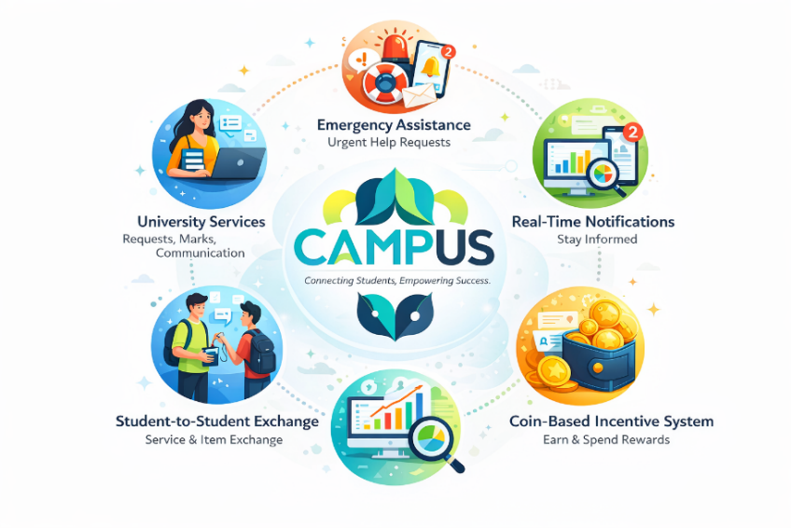

Project Overview
CampUs(The Super Smart University Service Exchange & Management Platform with addition of Integrated Student Support & Academic Service Platform) is a full-stack web application designed to provide a centralized digital ecosystem for university students, faculty, and administrators and also the outsiders.
The platform combines:
University services (requests, marks, communication)
Student-to-student service & item exchange
Emergency assistance
Coin-based incentive system
Real-time notifications
Analytics for monitoring system performance
Nearby outsider support
Events , Workshops and more…
The system is built using a modern scalable architecture with secure authentication, role-based access control, analytics, and containerized deployment.
Notes:
New Courses replaced with New Programmes

Slide 4
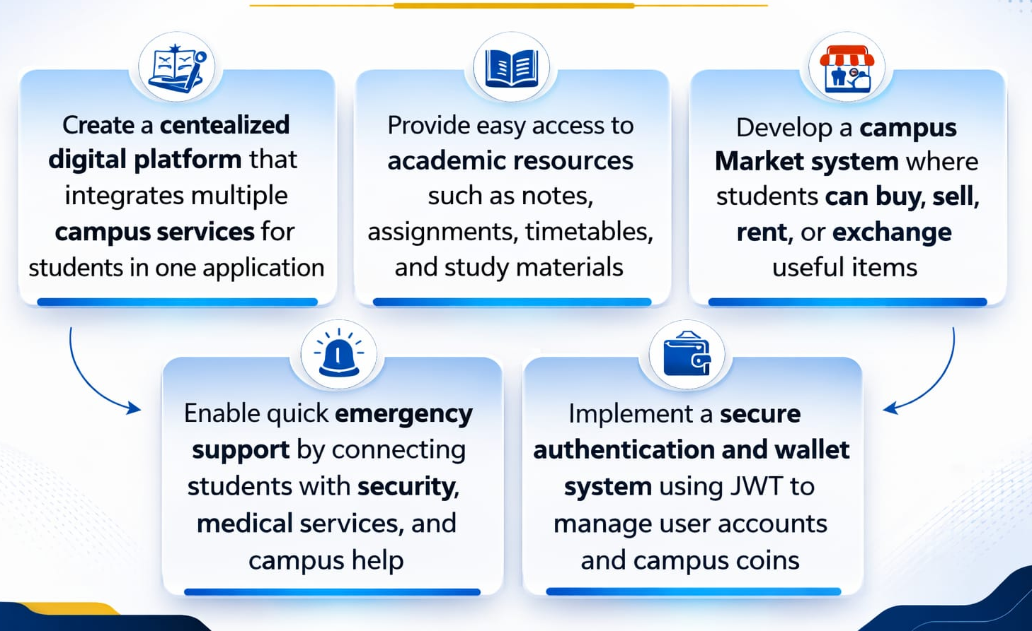
Specific Objectives
Notes:
New Courses replaced with New Programmes

Slide 5
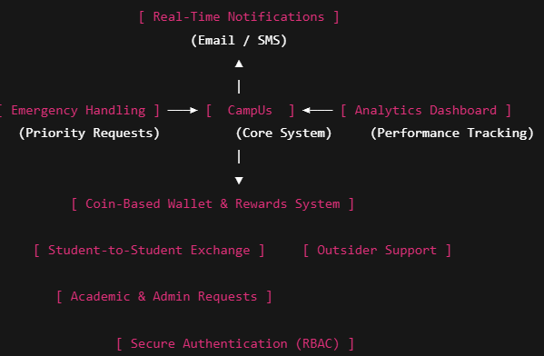
Key Features
Centralized smart dashboard
Academic and administrative request management
Student-to-student item and service exchange
Outsider/community partner support for urgent needs
Coin-based reward and wallet system
Emergency request handling with priority
Real time notifications (Email/SMS)
Analytics dashboard for monitoring performance
Secure authentication with RBAC
Notes:
New Courses replaced with New Programmes

Slide 6
Detailed Progress – Development Phase
Designed and planned the CampUs platform to connect students through a single digital campus ecosystem.
• Developed the system architecture using the MERN stack (React.js, Node.js, Express.js, MongoDB).
• Implemented secure user authentication system with login and registration functionality using JWT.
• Created a student dashboard interface providing access to Market, Academic, Emergency, Wallet, and Profile modules.
• Built the Campus Market module allowing students to buy, sell, and exchange items within the campus community.
• Designed the Academic section framework for sharing notes, assignments, timetable, and study resources.
• Integrated backend APIs and MongoDB database for managing users, requests, and platform data.
• Containerized the application using Docker for deployment and scalability, enabling easier hosting and future cloud deployment.
Notes:
New Courses replaced with New Programmes

Slide 7
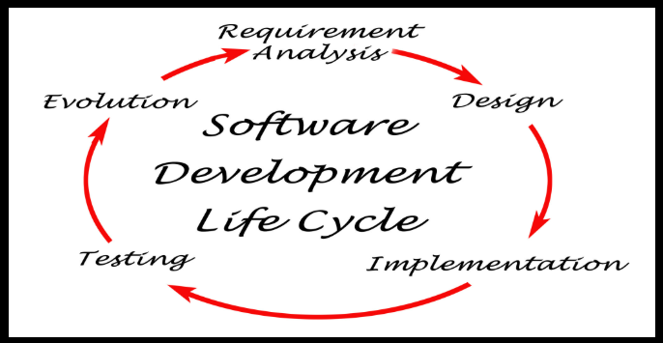
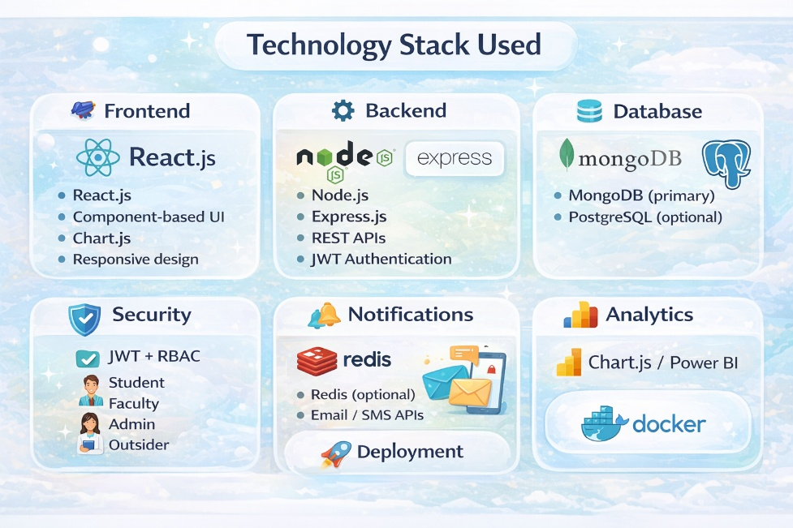
Methodology
Tools & Technologies Used
Frontend: React.js, Chart.js
Backend: Node.js, Express.js
Database: MongoDB, PostgreSQL
Security: JWT, RBAC
Notifications: Redis, Email/SMS APIs
Deployment: Docker
Approach Used
Requirement analysis
System and database design
Frontend & backend development
Workflow implementation
Testing and validation
Deployment
Notes:
New Courses replaced with New Programmes

Slide 8
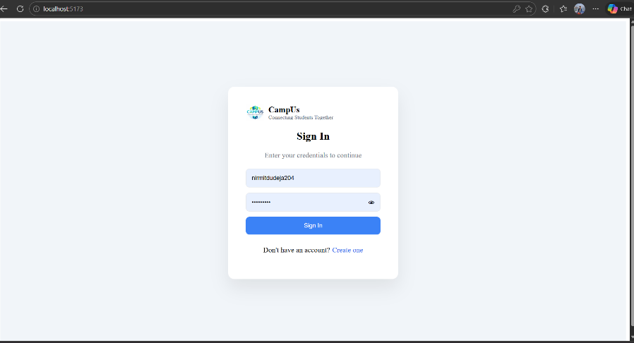
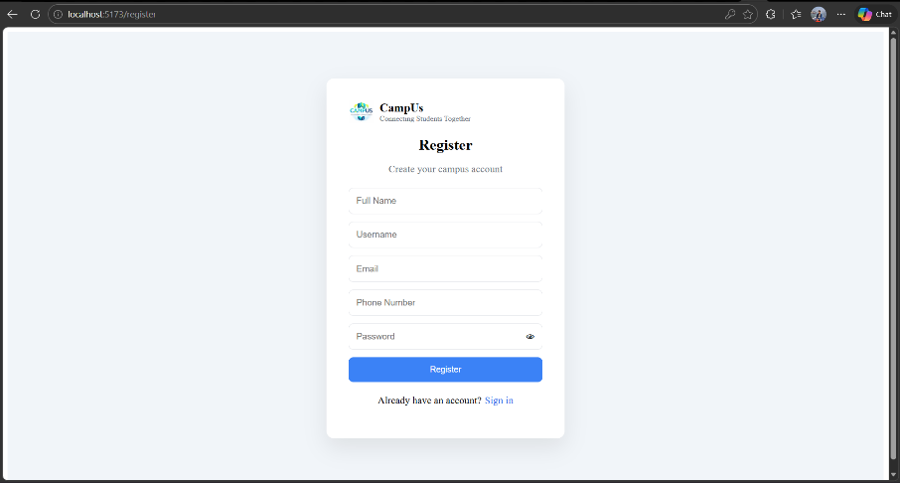
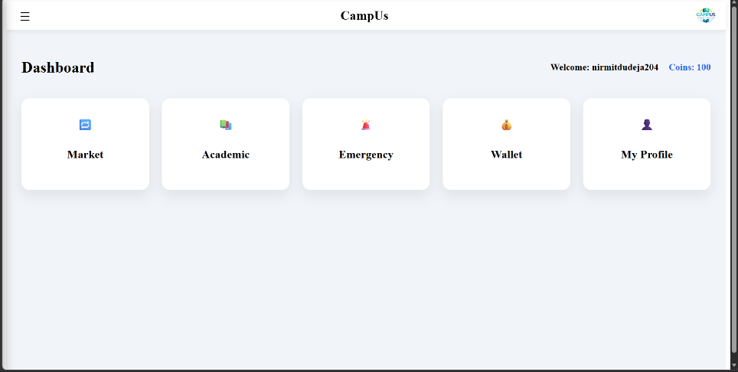
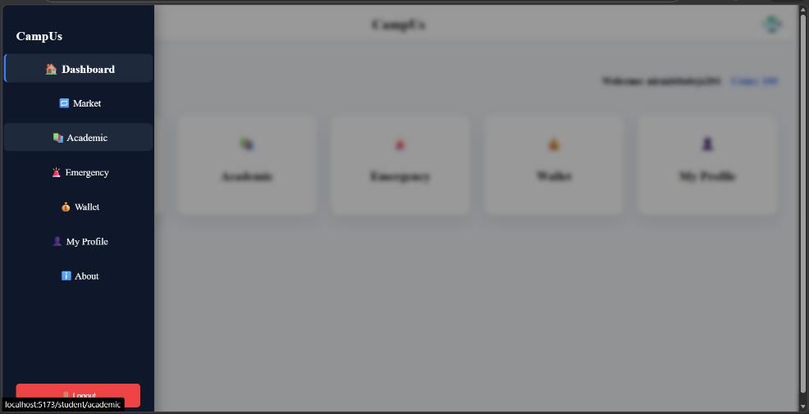

Prototype
Notes:
New Courses replaced with New Programmes

Slide 9
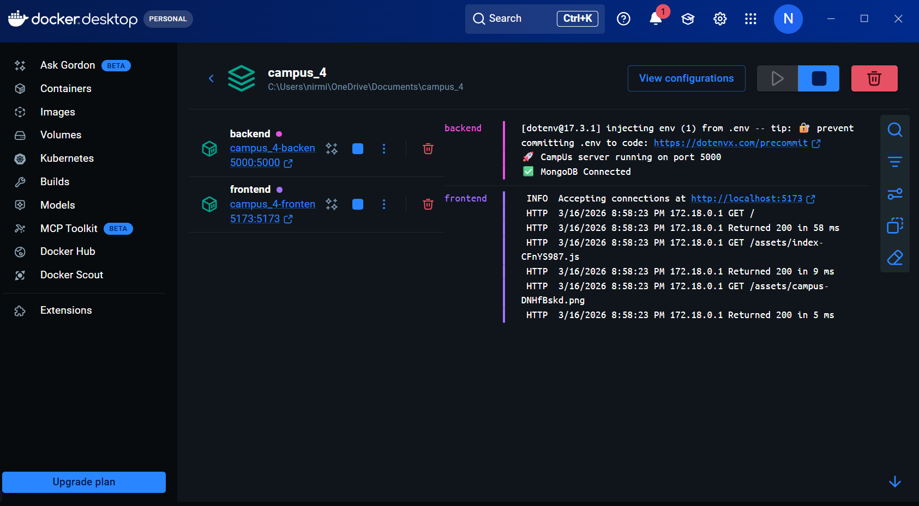
Docker Deploy
Notes:
New Courses replaced with New Programmes

Slide 10
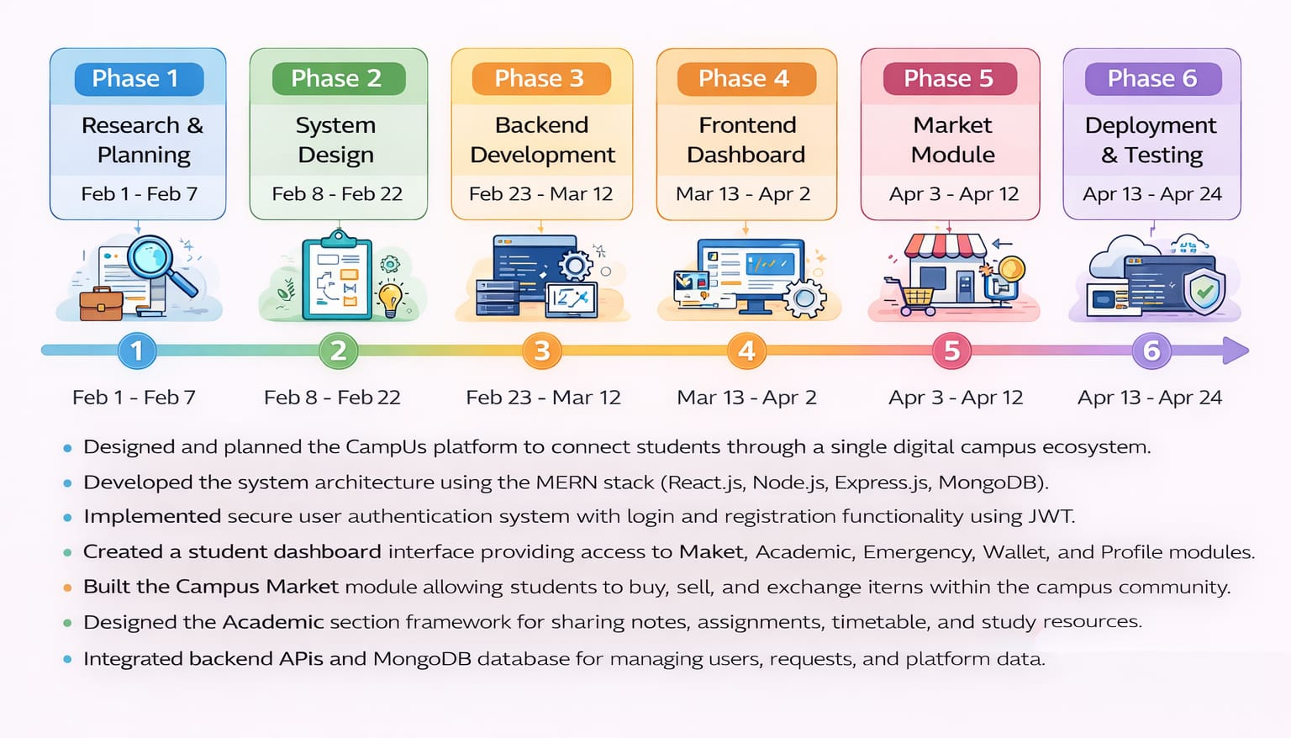
Project Timeline
Notes:
New Courses replaced with New Programmes

Slide 11
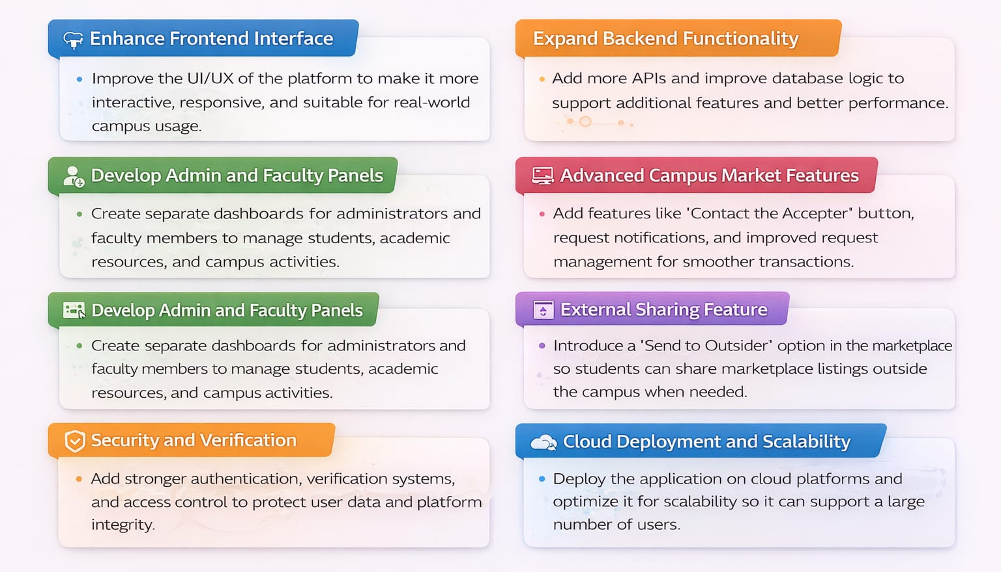
Next Steps and Goals
Notes:
New Courses replaced with New Programmes

Slide 12
Data & Resources
Data
• User Data – Student profile information stored in MongoDB
• Marketplace Requests – Buy/sell/exchange item data
• Academic Resource Data – Notes, assignments, and timetable information.
Resources
• React.js – Used for building the frontend user interface of the CampUs platform.
https://react.dev
• Node.js – Used for backend server development.
https://nodejs.org
• Express.js – Used for creating REST APIs and handling backend routes.
https://expressjs.com
• MongoDB – Used as the database for storing users, marketplace requests, and platform data.
https://www.mongodb.com
• Docker – Used for containerization and deployment of frontend and backend services.
https://www.docker.com⁠
Notes:
New Courses replaced with New Programmes

Slide 13
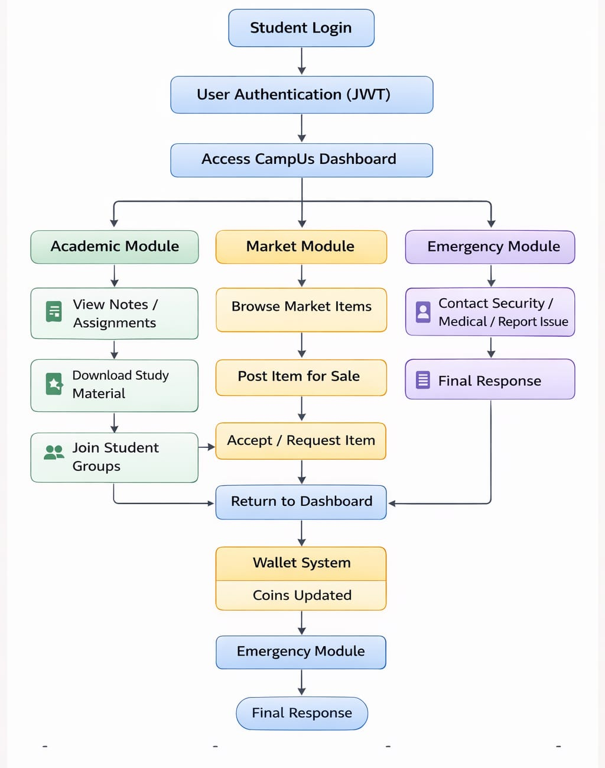
Usecases
The CampUs system allows students to securely access academic resources, participate in the campus market, manage wallet coins, and request emergency support through a centralized dashboard. The backend processes user actions and updates the database to ensure smooth campus interactions.
Notes:
New Courses replaced with New Programmes

Slide 14
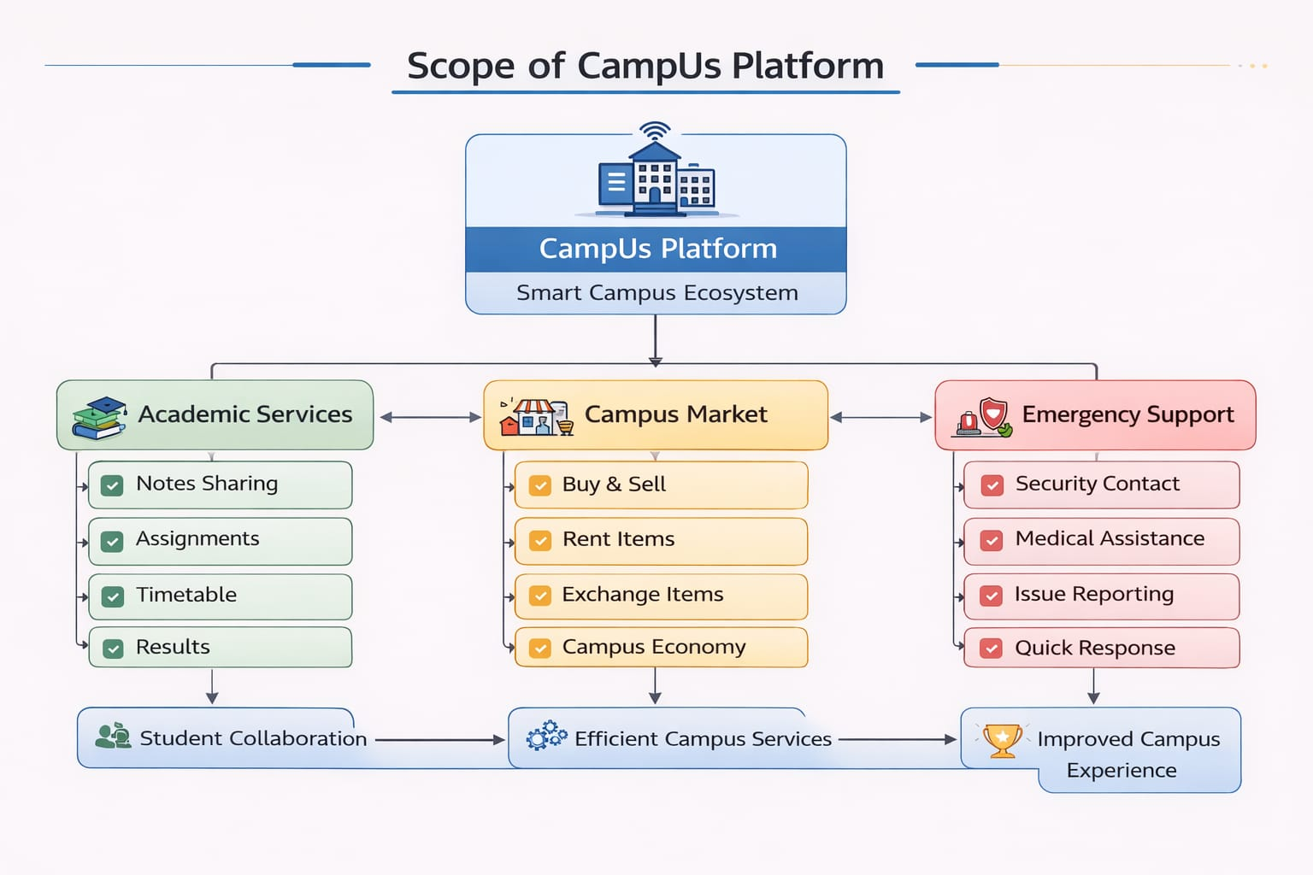
Scope
Notes:
New Courses replaced with New Programmes

Slide 15
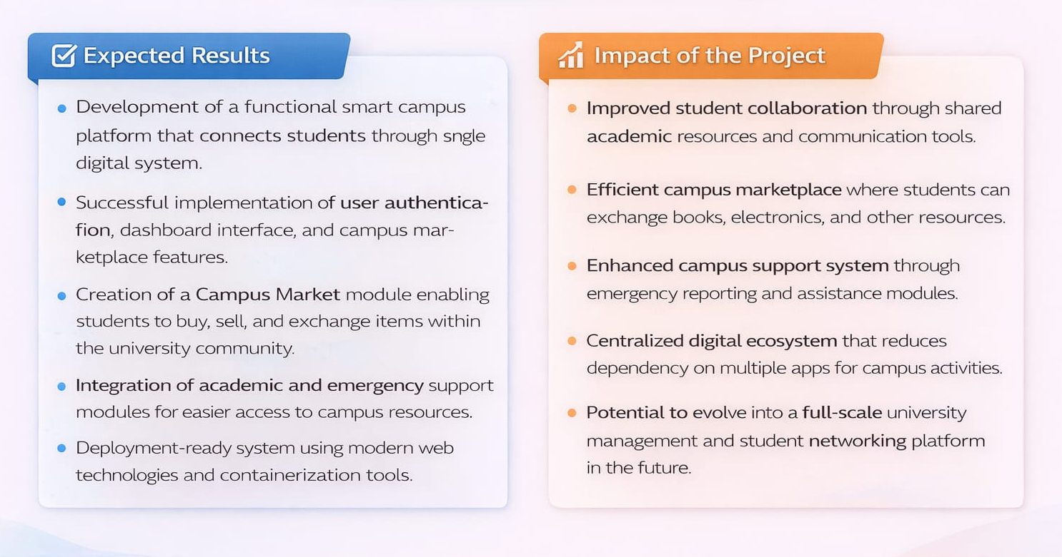
Expected Results & Impact
Notes:
New Courses replaced with New Programmes

Slide 16
THANK YOU

